Slide 1
Chapter 3: Processes
March， 2024

Slide 2
Chapter 3: Processes
Process Concept
Process vs Program
Resources
Process Control Block
Process State
Process Scheduling
Operations on Processes
fork()

Slide 3
Objectives
To introduce the notion of a process --- a program in execution, which forms the basis of all computation
To describe the various features of processes, including scheduling, creation and termination, etc.

Slide 4

Process Concept
An operating system executes a variety of programs:
Batch system – jobs
Multi-tasking
Picture generated by AI
Notes:
从单道程序，讲到多道程序，讲到切换、上下文，引入管理需求，引出进程的概念

Slide 5
Process Concept
An operating system executes a variety of programs:
Batch system – jobs
Multi-programming
Player
Program Counter
QQ
Word
Notes:
从单道程序，讲到多道程序，讲到切换、上下文，引入管理需求，引出进程的概念

Slide 6
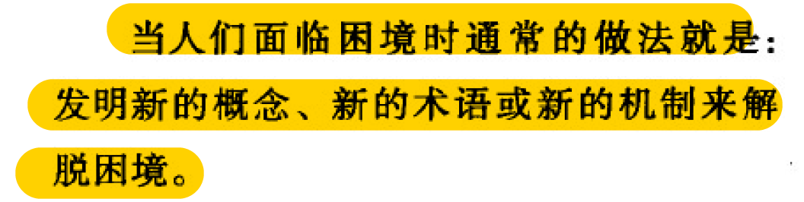
Process Concept
An operating system executes a variety of programs:
Batch system – jobs
Multi-programming
－－《操作系统之哲学原理》
Process
Notes:
从单道程序，讲到多道程序，讲到切换、上下文，引入管理需求，引出进程的概念

Slide 7
Program vs Process

Slide 8
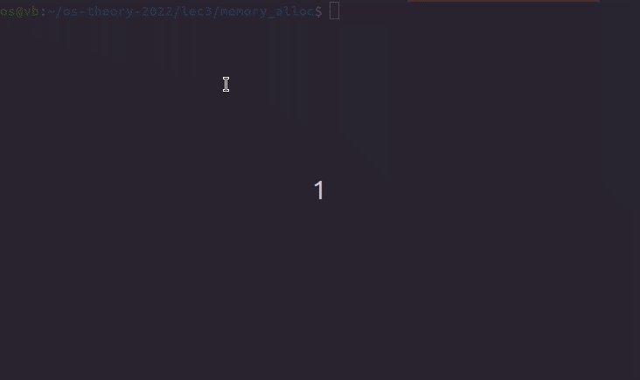
An Empty Program
Notes:
size a.out
text data bss dec hex filename
1418 544 8 1970 7b2 a.out
objdump -S a.out

Slide 9
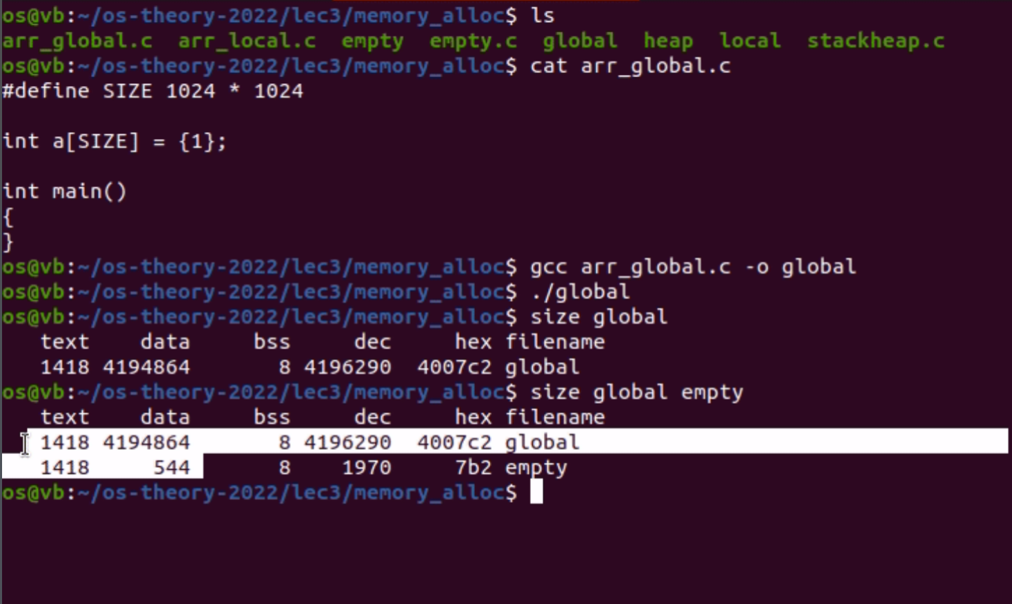
Demo: global

Slide 10
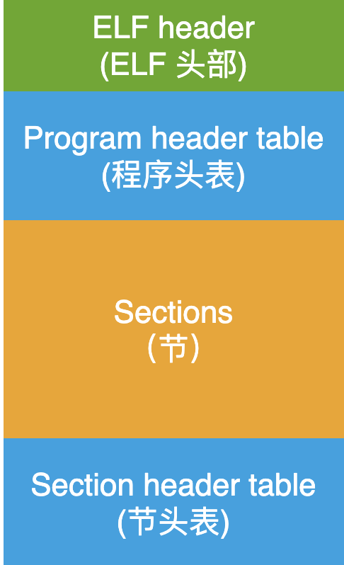
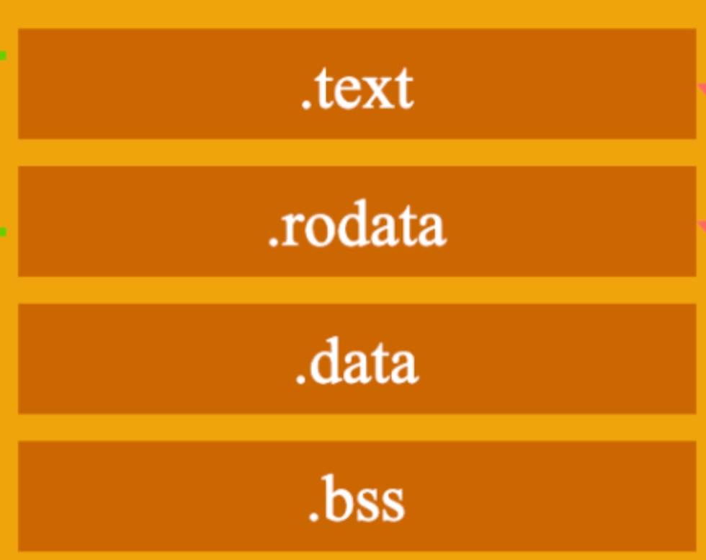
Program on Disk

Slide 11
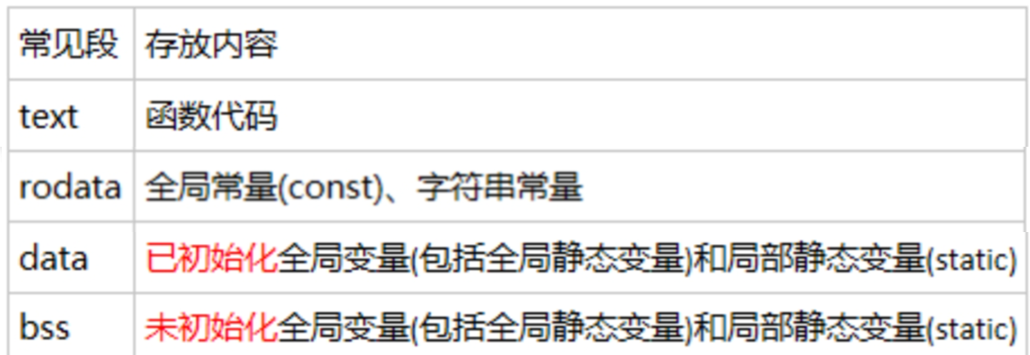
Program on Disk
Notes:
bss是英文Block Started by Symbol的缩写（奇怪的历史遗留），用于存放编译阶段无法确定的全局数据，包括未初始化的全局变量和静态变量。可执行程序不含bss段，只记录区域大小；进程为bss段开辟内存空间，并清零。从优化的角度出发，初始化为零的全局变量，也会被放进bss段从大压缩可执行文件的大小。

Slide 12
Program on disk
0
ELF header
Maps contiguous file sections to runtime memory segments
Program header table
.init
Read-only memory segment
(code segment)
.text
.rodata
.data
Read/write memory segment
(data segment)
.bss
.symtab
.debug
Symbol table and debugging info are not
loaded into memory
.line
Describes object file sections
.strtab
Section header table
Notes:
Rodata：全局常量、字符串常量（看上图属于read only memory segment）
Data：已初始化的全局变量、static
Bss：未初始化的

Slide 13
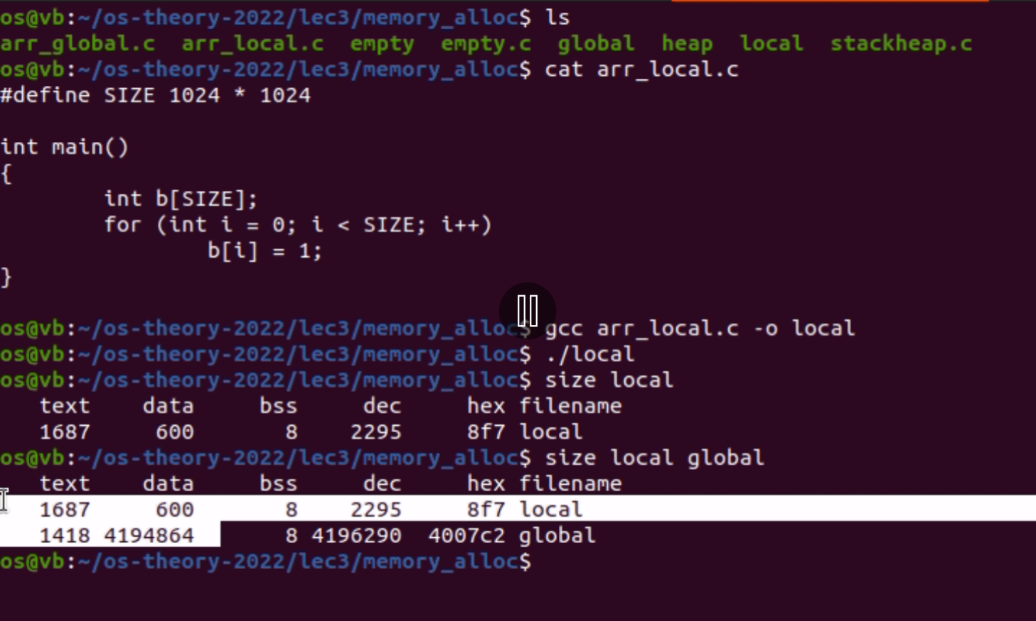
Program in memory： local variable
Notes:
这个数组应该开辟在stack，在执行过程中开辟。

Slide 14
Program in memory
Multiple parts
The program code, also called text section
Data section containing global, static, constant variables
Stack containing temporary data
Function parameters, return addresses, local variables
Heap containing memory dynamically allocated during run time

Slide 15
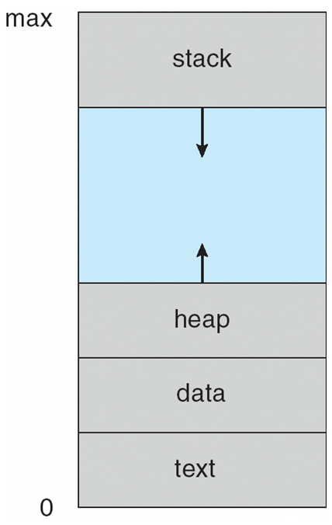
Process in Memory
内存创建

Slide 16
Process in Memory
内存创建
磁盘镜像
Notes:
可以看到已初始化的全局变量属于直接映射过来的，而不是动态开辟的。

Slide 17
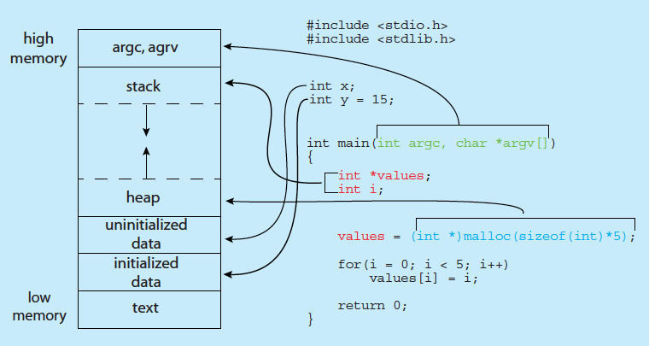
Process in Memory
demo
Notes:
size a.out
cat /proc/<pid>/maps
cat /proc/<pid>/maps | grep -E -w '[[]heap|stack’
Y属于初始化后的全局变量（在rodata中），x属于未初始化的全局变量（在bss中）

Slide 18
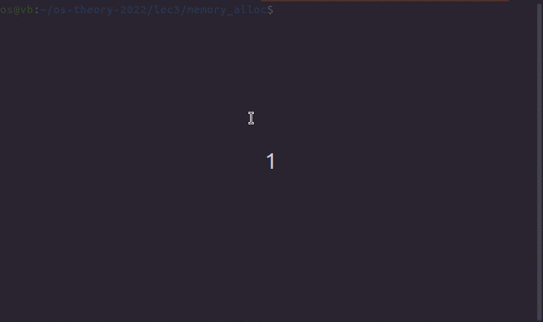
Demo: address

Slide 19
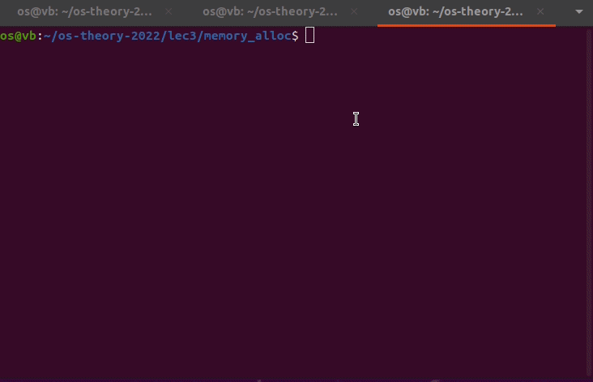
Demo: mapping

Slide 20
Why Dynamic Allocation

Slide 21
Registers
Program Counter
Notes:
程序计数器（PC）存放的是下一条指令的地址

Slide 22
Scheduling
memory
Program Counter
Notes:
本页引出下一页life cycle

Slide 23
Life Cycle
time
Program Counter
memory

Slide 24
Summary
To run a program

Slide 25
Process Concept (Cont.)
Program is a passive entity stored on disk (executable file), process is active
Program becomes process when executable file loaded into memory
Execution of program started via GUI mouse clicks, command line entry of its name, etc
Life cycle
Resources
One program can be several processes (Demo: cmd)
Process = program + execution

Slide 26
Management of Process in OS

Slide 27
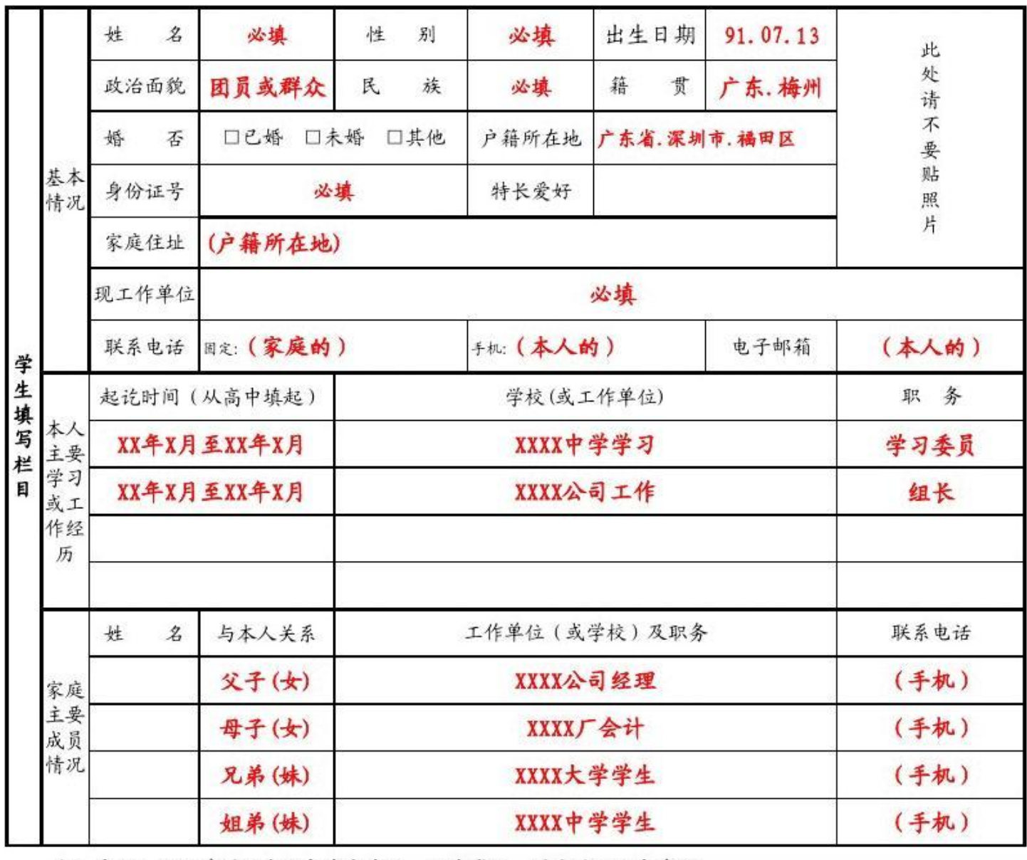

学籍管理

Slide 28
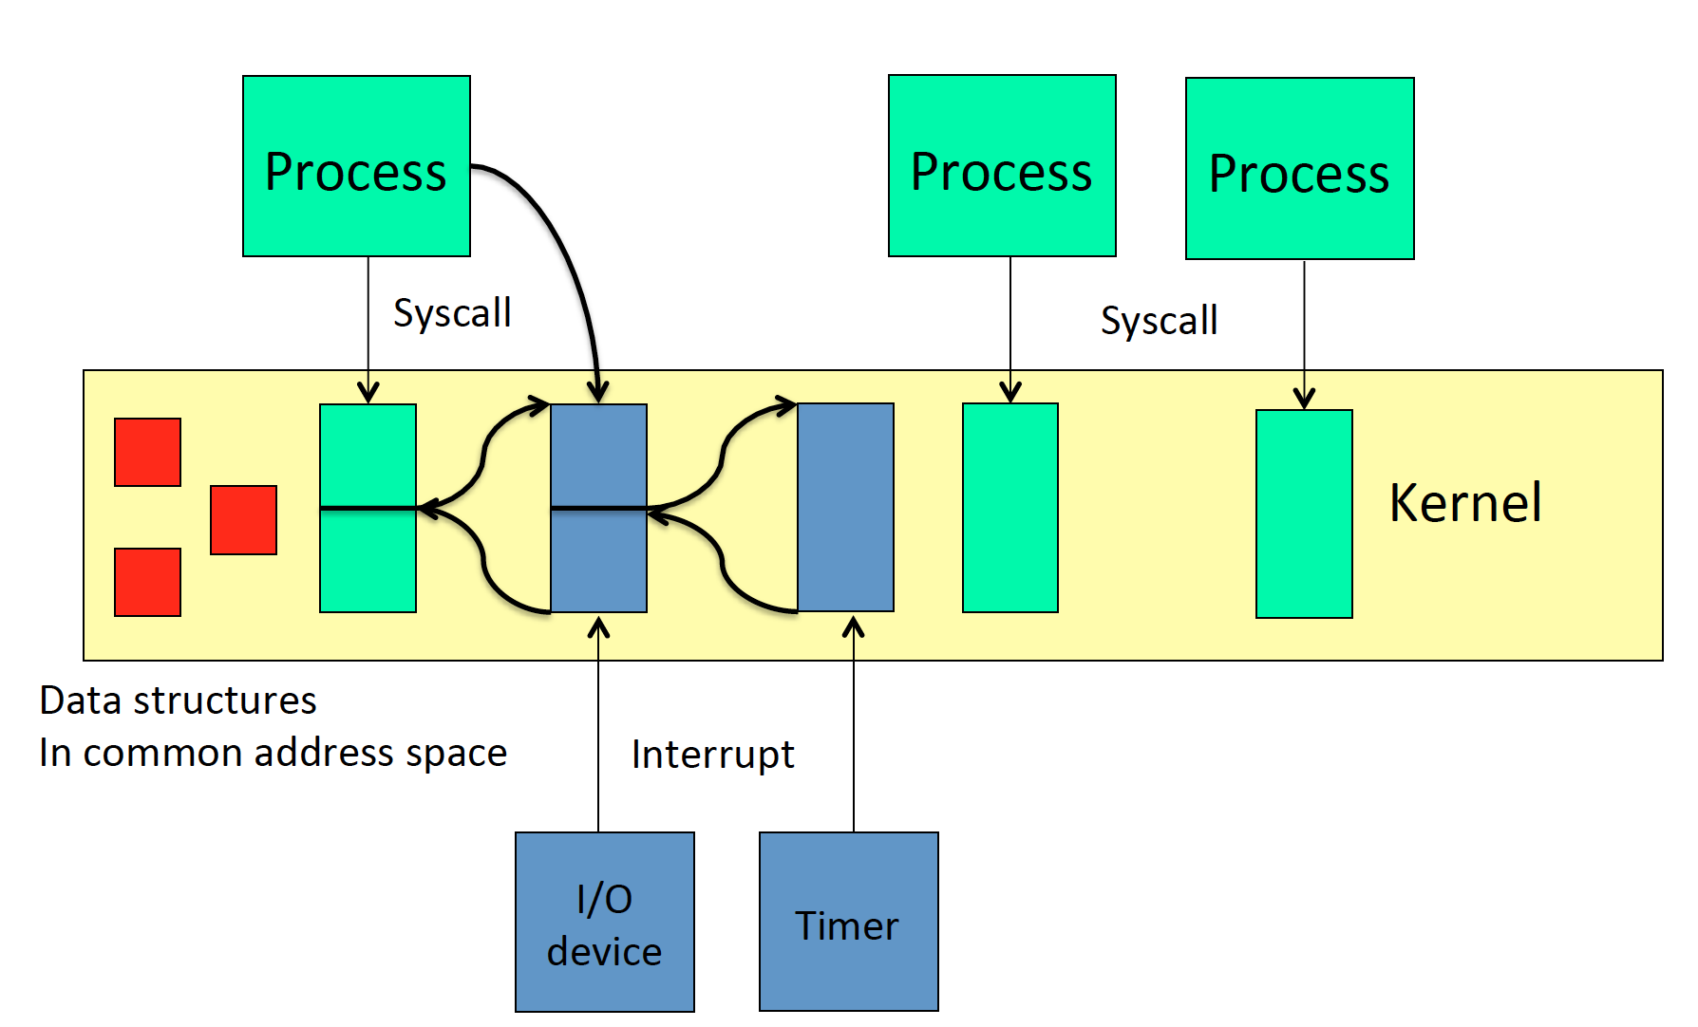
Lecture 2
Notes:
data structures: PCB etc.

Slide 29
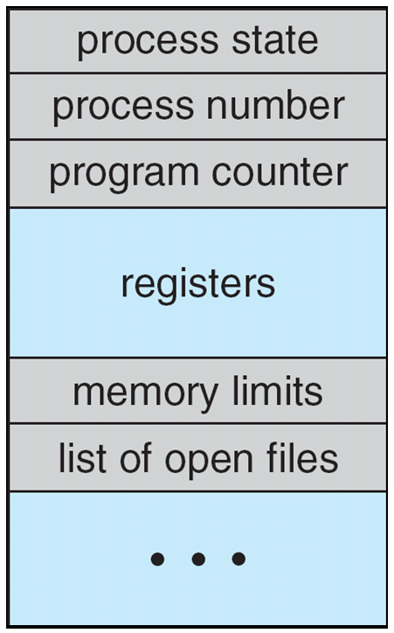
Process Control Block —— PCB
Information associated with each process
Process identifier – number
Program counter – location of instruction to next execute
CPU registers – contents of all process-centric registers
Memory-management information – memory allocated to the process
I/O status information – I/O devices allocated to process, list of open files
Process state – running, waiting, etc
CPU scheduling information – priorities, scheduling queue pointers
Accounting information – CPU used, clock time elapsed since start, time limits
Notes:
Identifier, pc, registers, memory management info(page table), io status, process state, scheduling info, time limits

Slide 30
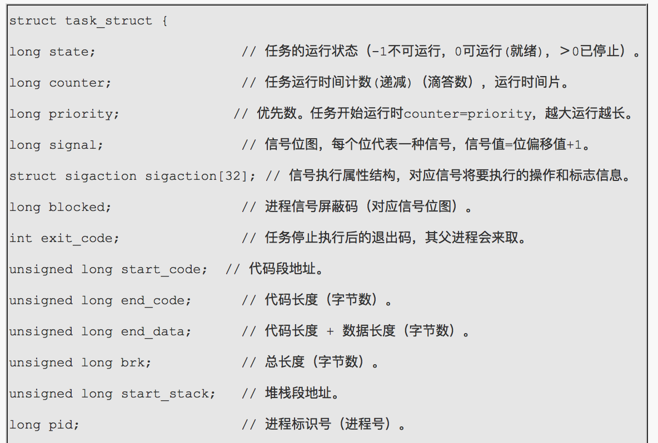
The Linux PCB Structure （V0.11）
Notes:
//最新版本linux的进程进程控制块？

Slide 31
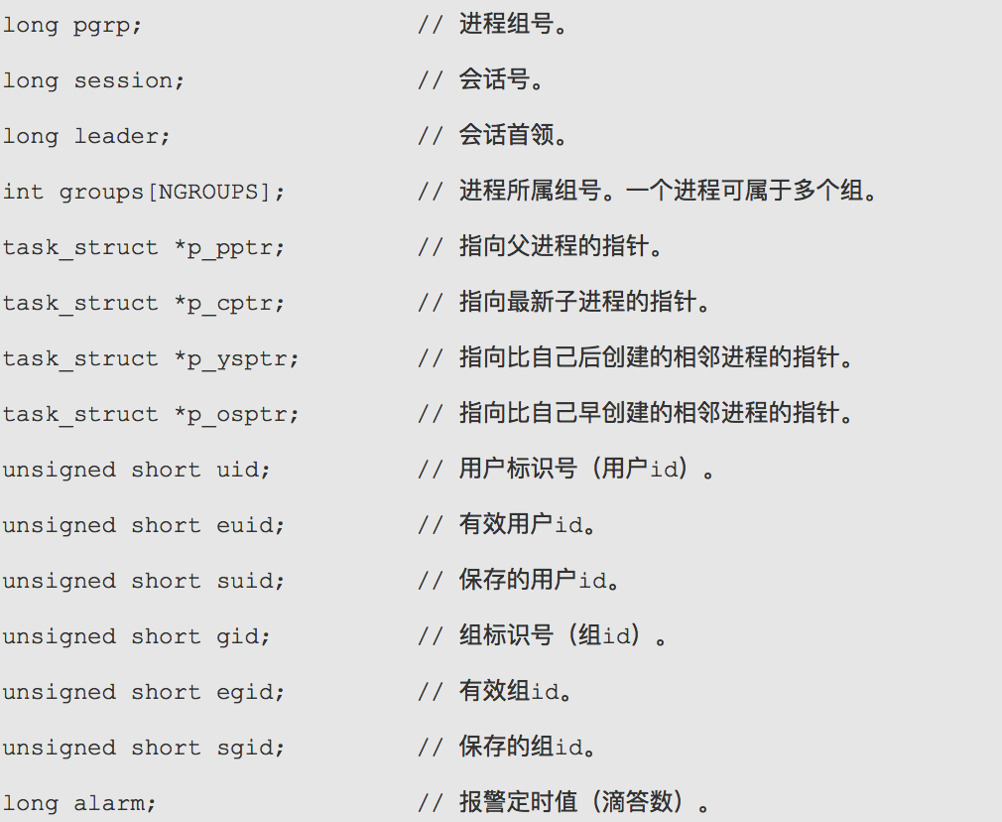
The Linux PCB Structure （V0.11）

Slide 32
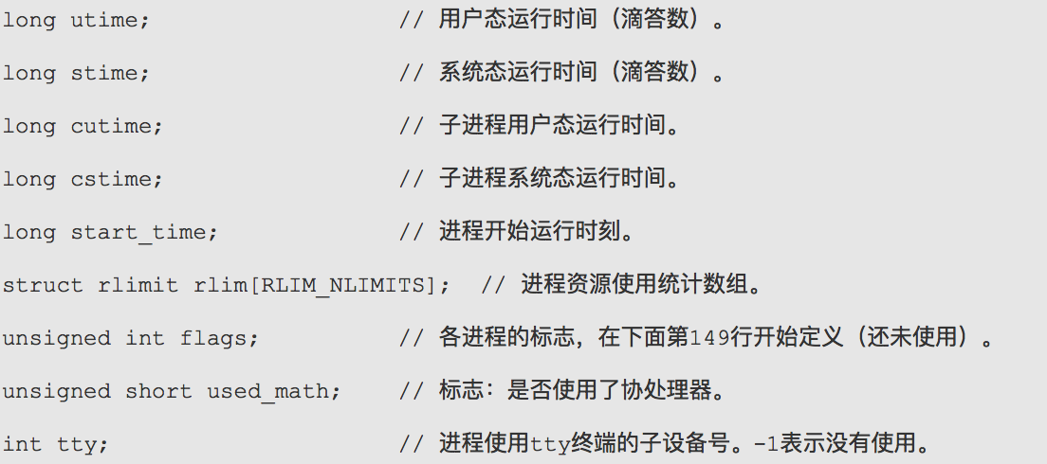
The Linux PCB Structure （V0.11）

Slide 33
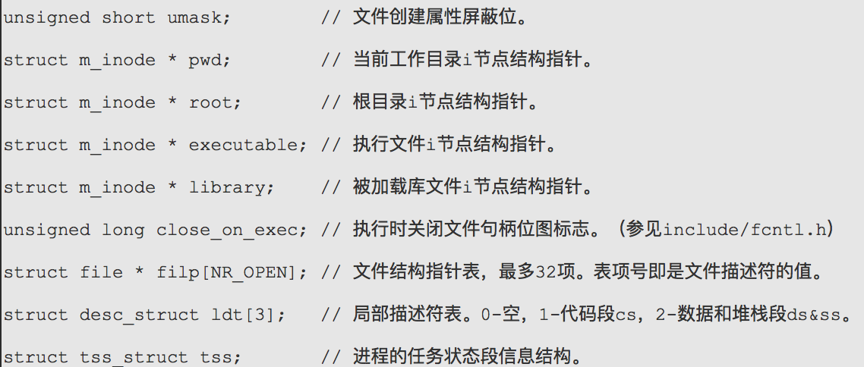
The Linux PCB Structure （V0.11）

Slide 34
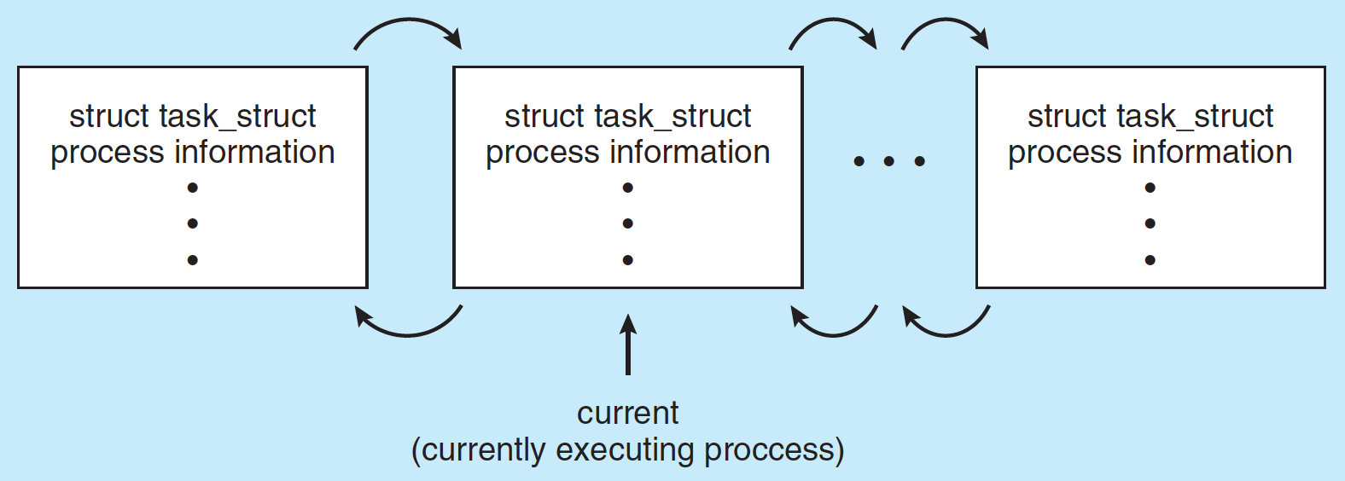
Process Representation in Linux
Represented by the C structure task_struct

Slide 35
Process Control Block -- PCB
Information associated with each process
Process identifier – number
Program counter – location of instruction to next execute
CPU registers – contents of all process-centric registers
Memory-management information – memory allocated to the process
I/O status information – I/O devices allocated to process, list of open files
Process state – running, waiting, etc
CPU scheduling information – priorities, scheduling queue pointers
Accounting information – CPU used, clock time elapsed since start, time limits

Slide 36
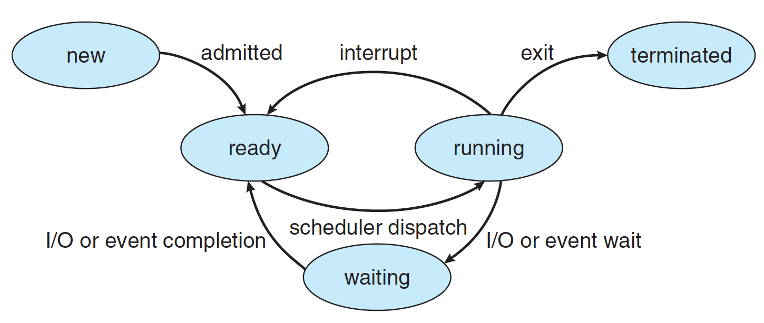
Diagram of Process State

Slide 37
Process State
As a process executes, it changes state
new: The process is being created
running: Instructions are being executed
waiting: The process is waiting for some event to occur
ready: The process is waiting to be assigned to a processor
terminated: The process has finished execution

Slide 38
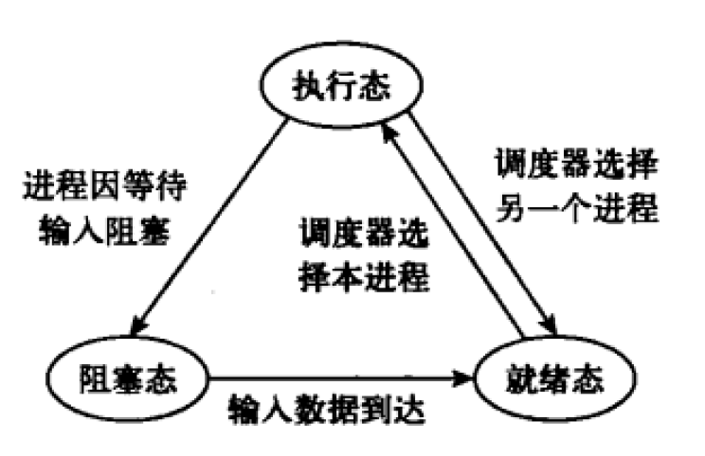
Three States

Slide 39

Question
Program Counter
单核CPU
点击暂停
Player
QQ
Word
Notes:
进入了阻塞态，也就是等待队列，因为产生了外部中断

Slide 40
Process Control Block -- PCB
Information associated with each process
Process identifier – number
Program counter – location of instruction to next execute
CPU registers – contents of all process-centric registers
Memory-management information – memory allocated to the process
I/O status information – I/O devices allocated to process, list of open files
Process state – running, waiting, etc
CPU scheduling information – priorities, scheduling queue pointers
Accounting information – CPU used, clock time elapsed since start, time limits

Slide 41
Process Scheduling
Maximize CPU use, quickly switch processes onto CPU for time sharing
Process scheduler selects among available processes for next execution on CPU
Maintains scheduling queues of processes
Ready queue – set of all processes residing in main memory, ready and waiting to execute
Device queues – set of processes waiting for an I/O device
Processes migrate among the various queues

Slide 42
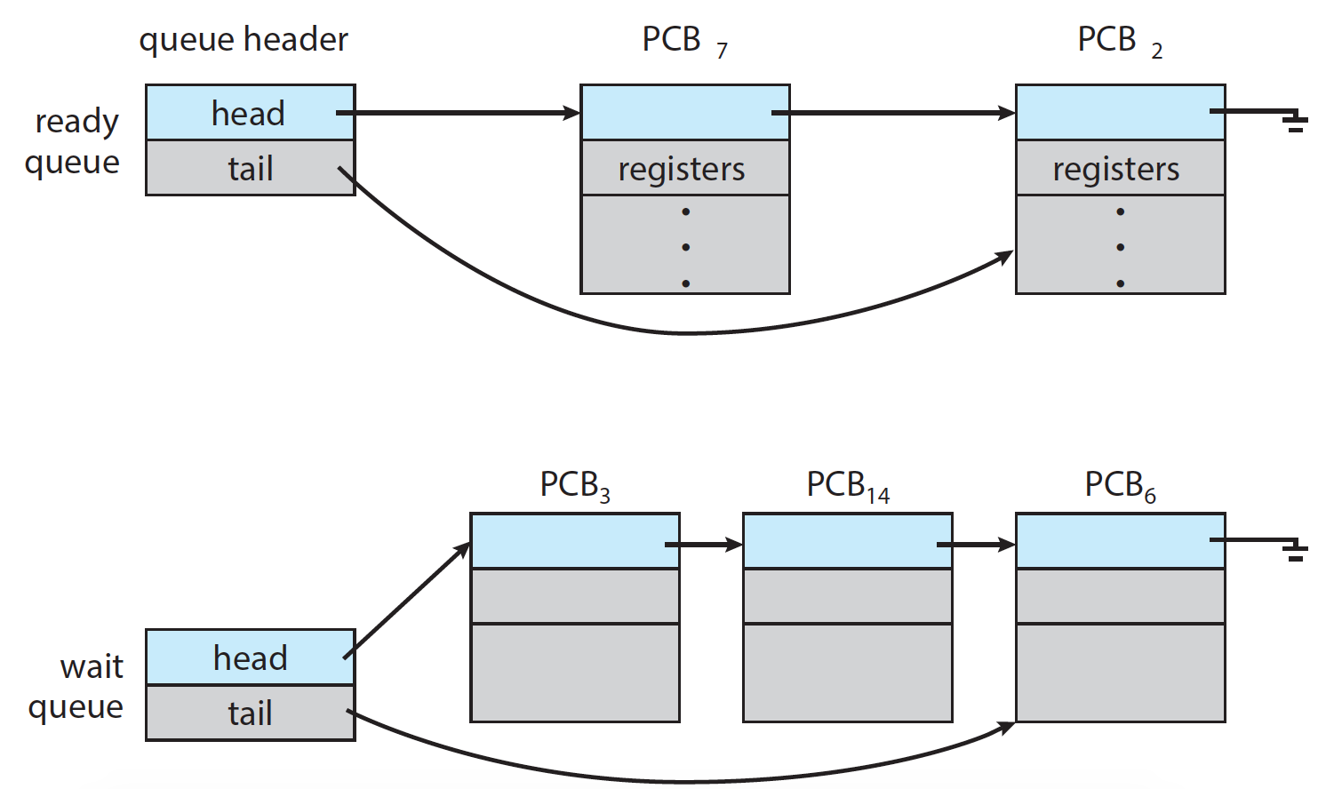
Ready Queue and Wait Queue

Slide 43
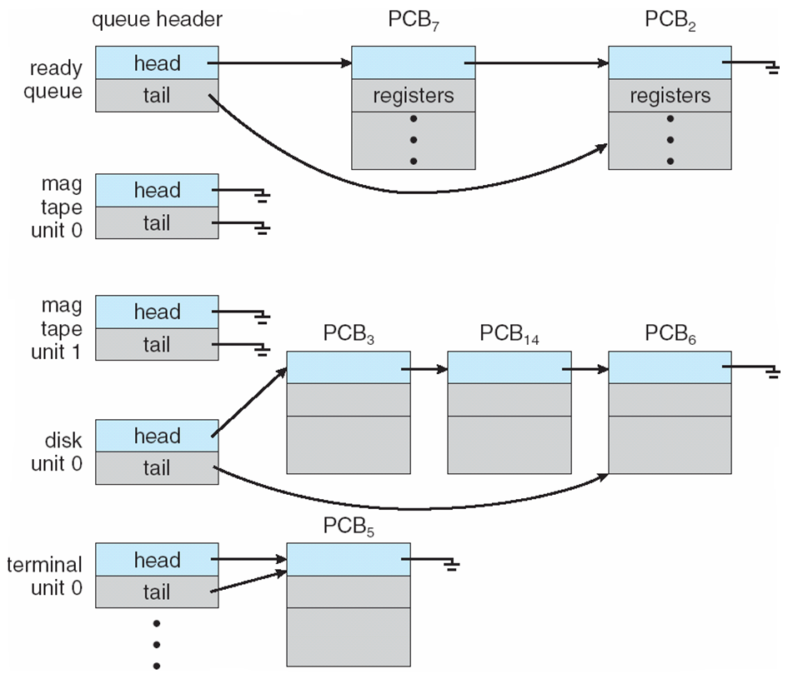
Ready Queue And Various I/O Device Queues

Slide 44
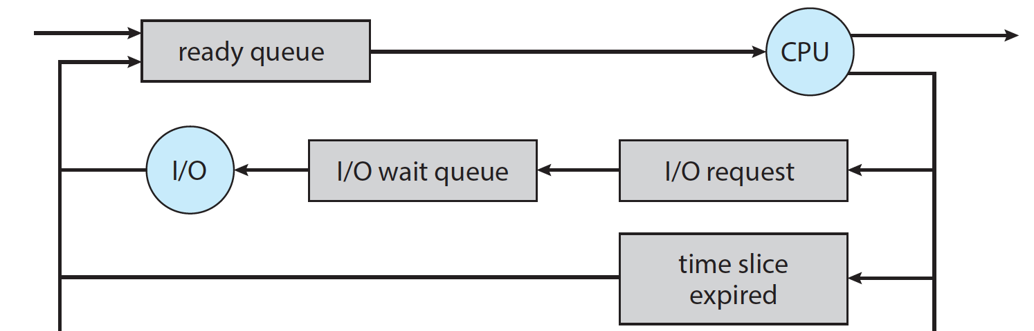
Representation of Process Scheduling
Queueing diagram represents queues, resources, flows
Notes:
Wait for interrupt to complete
Wait for child to exit

Slide 45
Schedulers
CPU scheduler – selects which process should be executed next and allocates CPU
Sometimes the only scheduler in a system
Short-term scheduler is invoked frequently (milliseconds) ⇒ (must be fast)
Processes can be described as either:
I/O-bound process – spends more time doing I/O than computations, many short CPU bursts
CPU-bound process – spends more time doing computations; few very long CPU bursts

Slide 46
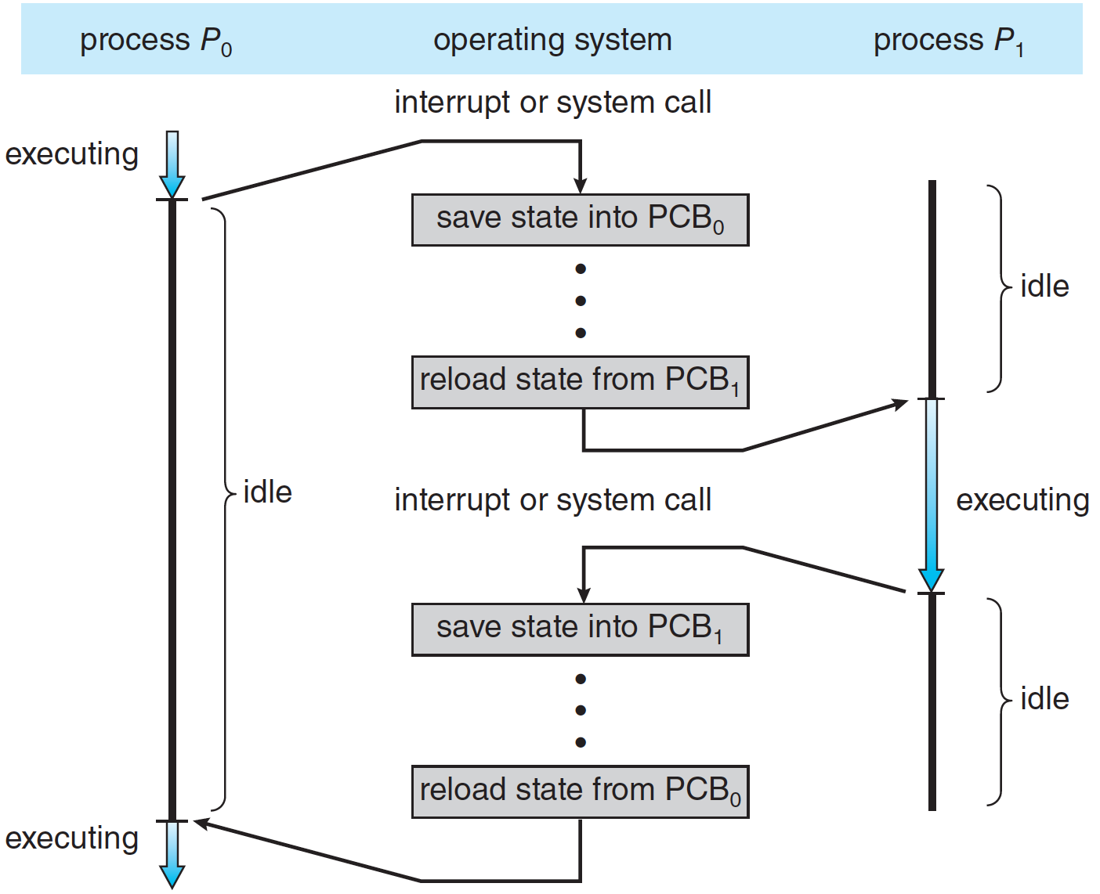
CPU Switch From Process to Process
Notes:
寄存器保存：内核栈 or TSS ？？？？

Slide 47
Context Switch
When CPU switches to another process, the system must save the context of the old process and load the saved context for the new process via a context switch
Context of a process represented in the PCB
It includes the value of the CPU registers, the process state, and memory-management information, ….
Context-switch time is overhead; the system does no useful work while switching
The more complex the OS and the PCB ➔ the longer the context switch

Slide 48
Summary of Process (single)
During the lift cycle of a process
State changes
Migrate among queues
time

Slide 49
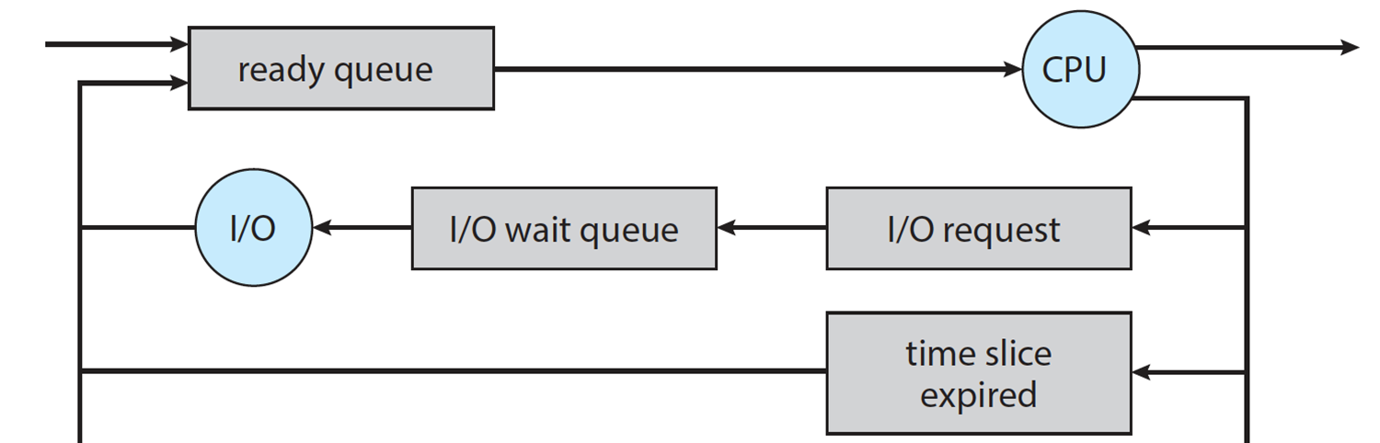
Summary of Process (single)
During the lift cycle of a process
State changes
Migrate among queues

Slide 50
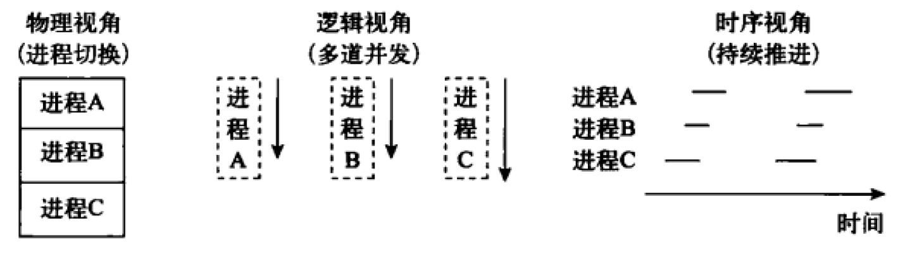
Summary of Process (multiple)

Slide 51
Operations on Process

Slide 52
Operations on Processes
System must provide mechanisms for:
process creation
process termination
and so on as detailed next

Slide 53
Process Creation
Parent process create children processes, which, in turn create other processes, forming a tree of processes
Generally, process identified and managed via a process identifier (pid)

Slide 54
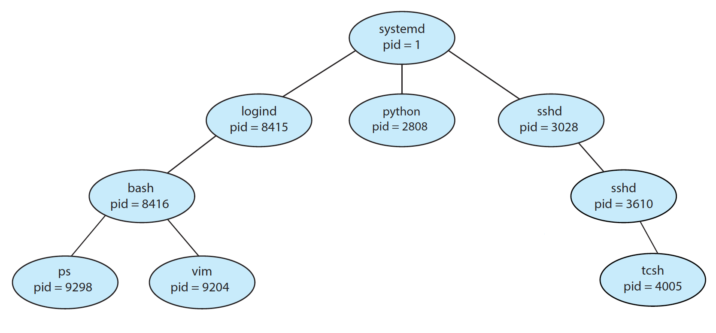
A Tree of Processes in Linux
demo
Notes:
ps -el
pstree -p <pid>

Slide 55
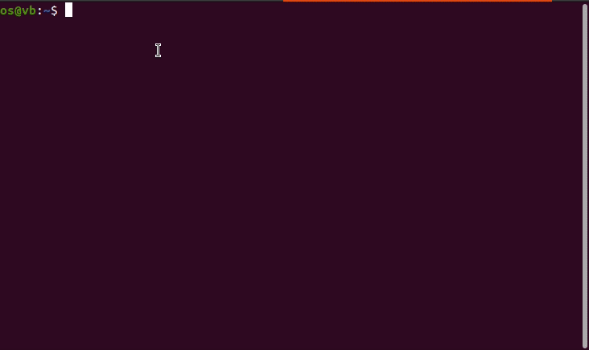
A Tree of Processes in Linux
Notes:
ps -el
pstree -p <pid>

Slide 56
Process Creation
Resource sharing options
Parent and children share all resources
Children share subset of parent’s resources
Parent and child share no resources
Execution options
Parent and children execute concurrently
Parent waits until children terminate

Slide 57
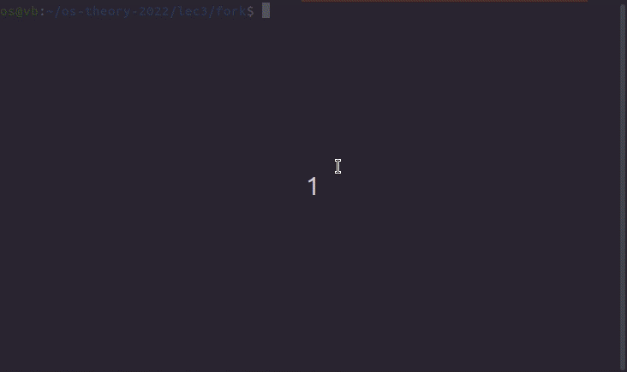
Process Creation (Cont.)
Linux example： fork()
Child duplicate of parent

Slide 58
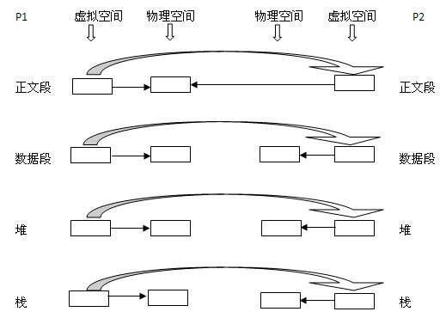
Process creation: fork()
Notes:
内存空间复制（代码段除外）
PCB复制（更改内存空间）

Slide 59
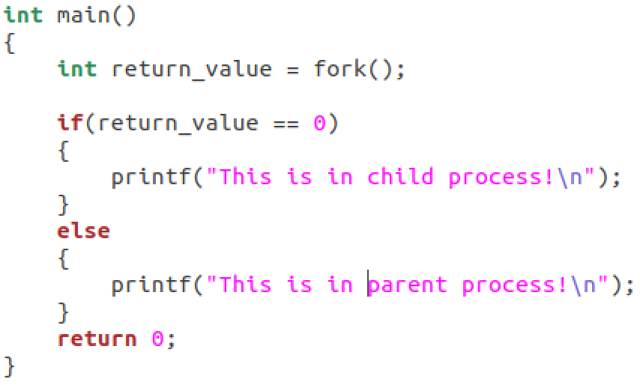
fork() example
parent
child
Notes:
整个复制一份，代码复制蓝线之后的部分。

Slide 60
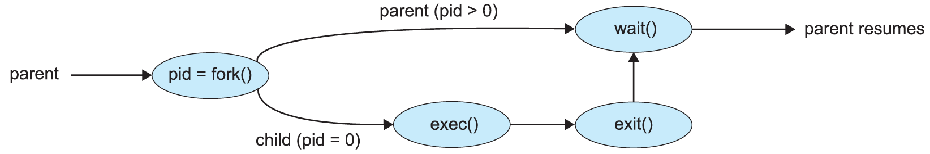
Process Creation (Cont.)
Linux examples
fork() system call creates new process
exec() system call used after a fork() to replace the process’ memory space with a new program

Slide 61
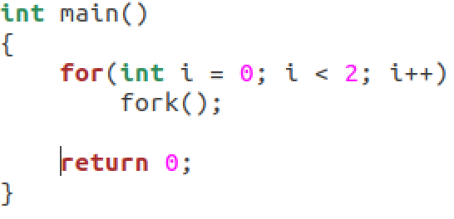
Exercise 1
子进程复制父进程fork()之后的代码。
父进程第一次fork的子进程中还有一句fork所以连续创建了两个，父进程第二次fork又创建一个，这次子进程没有复制过来任何代码。
所以加上父进程一共创建了4个进程
Notes:
子进程复制父进程fork()之后的代码。父进程第一次fork的子进程中还有一句fork所以连续创建了两个，父进程第二次fork又创建一个，这次子进程没有复制过来任何代码。所以加上父进程一共创建了4个进程

Slide 62
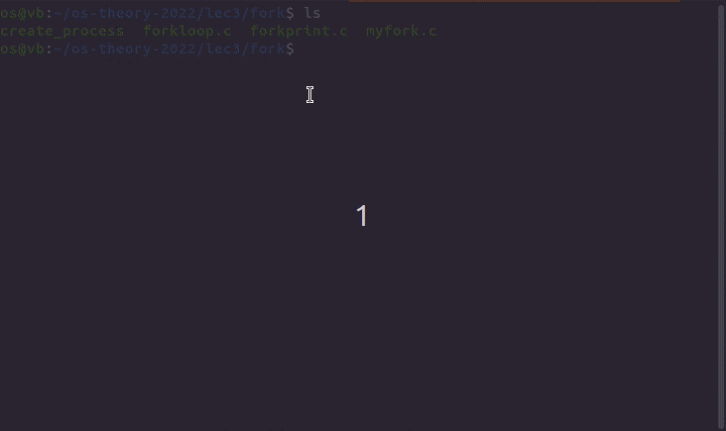
Result

Slide 63
Exercise 2
#include <sys/types.h>
#include <stdio.h>
#include <unistd.h>
int value = 5;
int main()
{
pid t pid;
pid = fork();
if (pid == 0) { /* child process */
value += 15;
return 0;
}
else if (pid > 0) { /* parent process */
wait(NULL);
printf("PARENT: value = %d",value); /* LINE A */
return 0;
}
}
Notes:
父子进程资源并不共享

Slide 64
End of Chapter 3

Slide 65
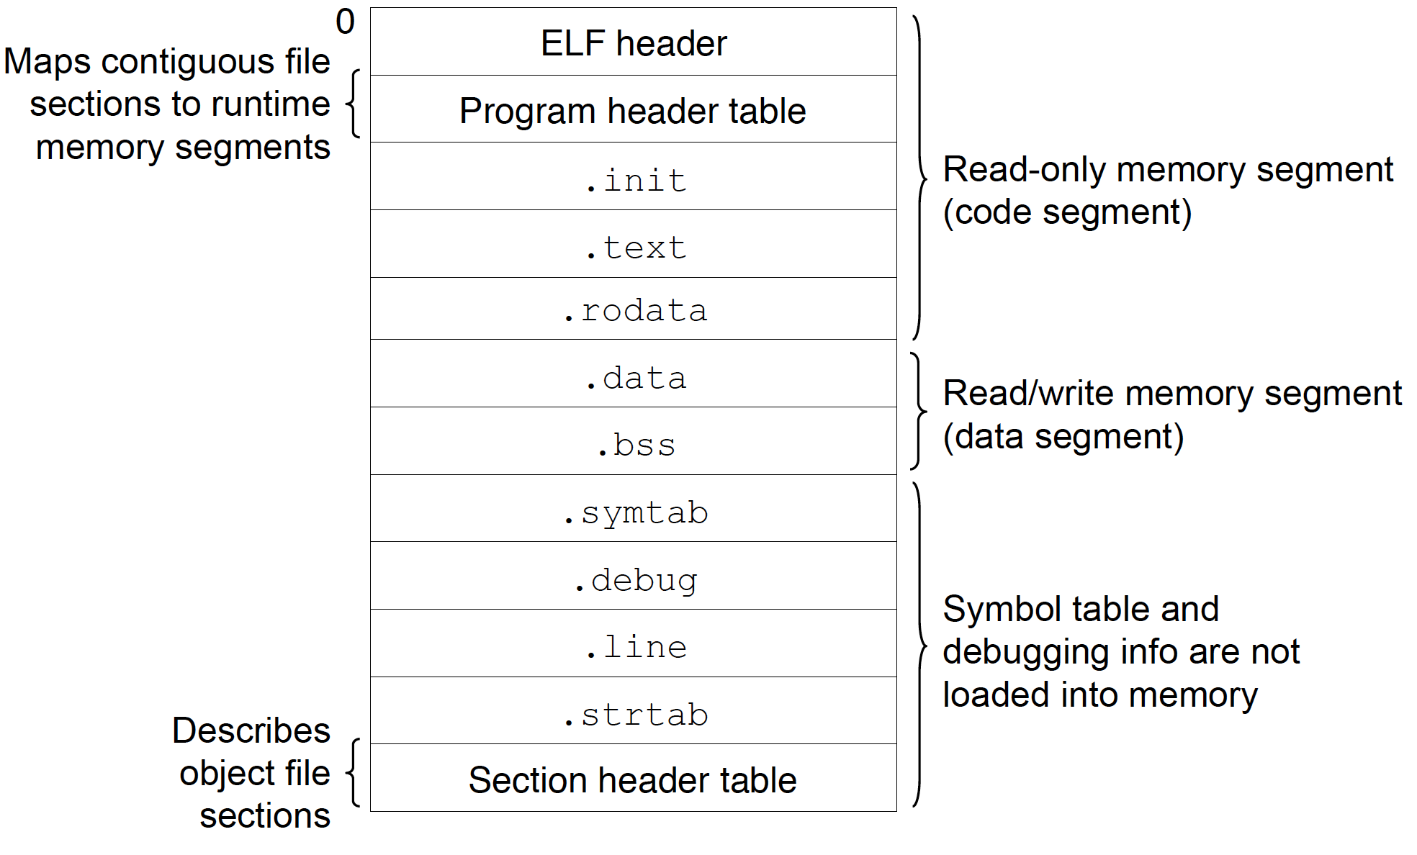
Program on disk
Notes:
file a.out
size a.out

Slide 66
Program on disk
demo
Notes:
Demo: The global array （如果初始化时指定的元素个数比数组大小少，剩下的元素都会被初始化为 0）
Size命令的输出不包括stack和heap的部分。只包括文本段(text), 代码段(data),未初始化数据段(bss)三部分。
1、文本段：包含程序的指令，它在程序的执行过程中一般不会改变。
2、数据段：包含了经过初始化的全局变量和静态变量，以及他们的值。
3、BSS段：包含未经初始化的全局变量和静态变量。
4、堆栈段：包含了函数内部声明的局部变量。当然，上面段的作用不仅于此，具体的作用
1、经过初始化的全局变量和静态变量保存在数据段中。
2、未经初始化的全局变量和静态变量保存在BSS段。
3、函数内部声明的局部变量保存在堆栈段中。
4、const修饰的全局变量保存在文本段中，const修饰的局部变量保存在堆栈段中。
5、字符串常量保存在文本段中。

Slide 67
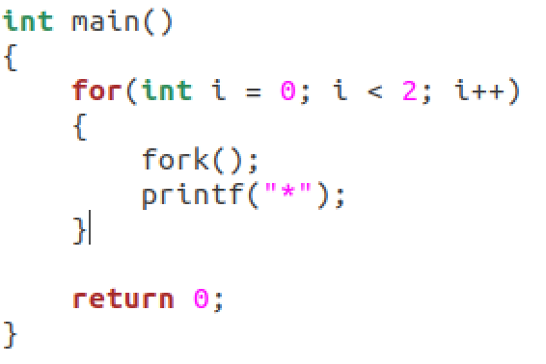
Exercise 2

Slide 68
More about fork（）

Slide 69
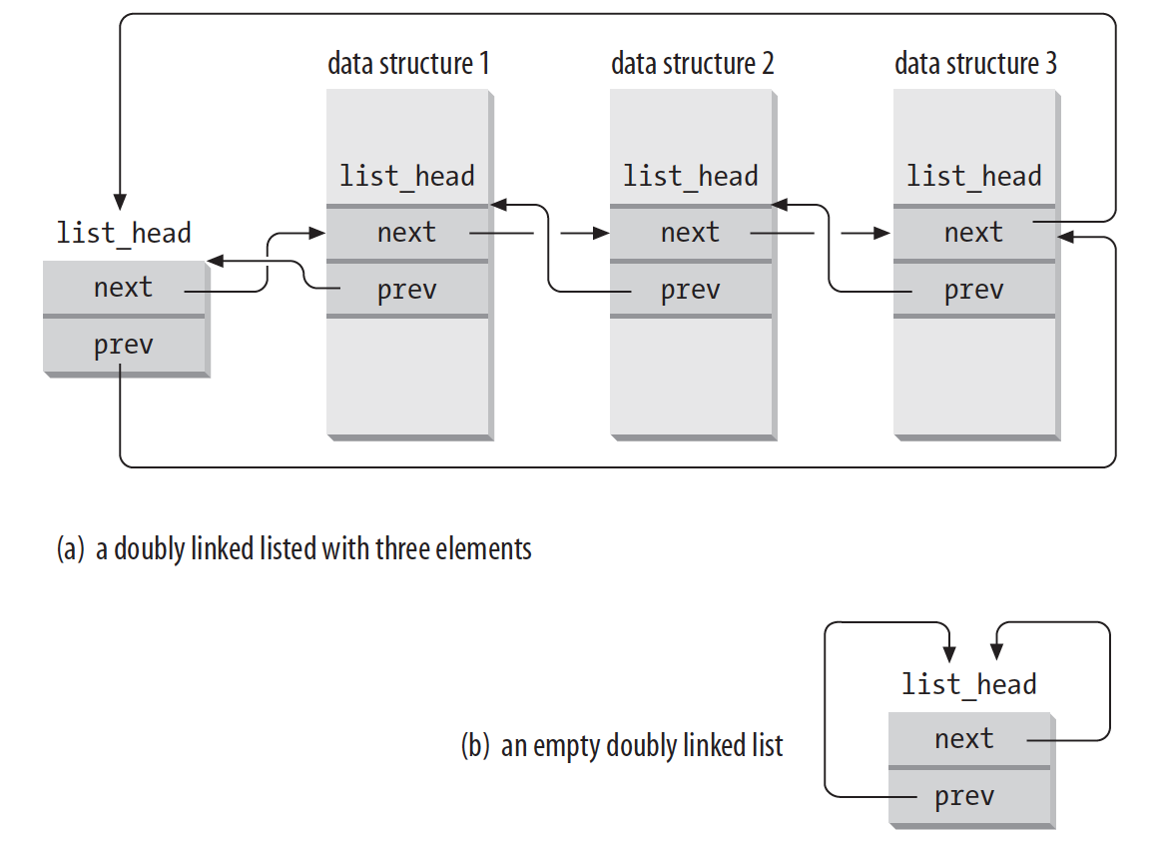
Circular doubly linked list

Slide 70
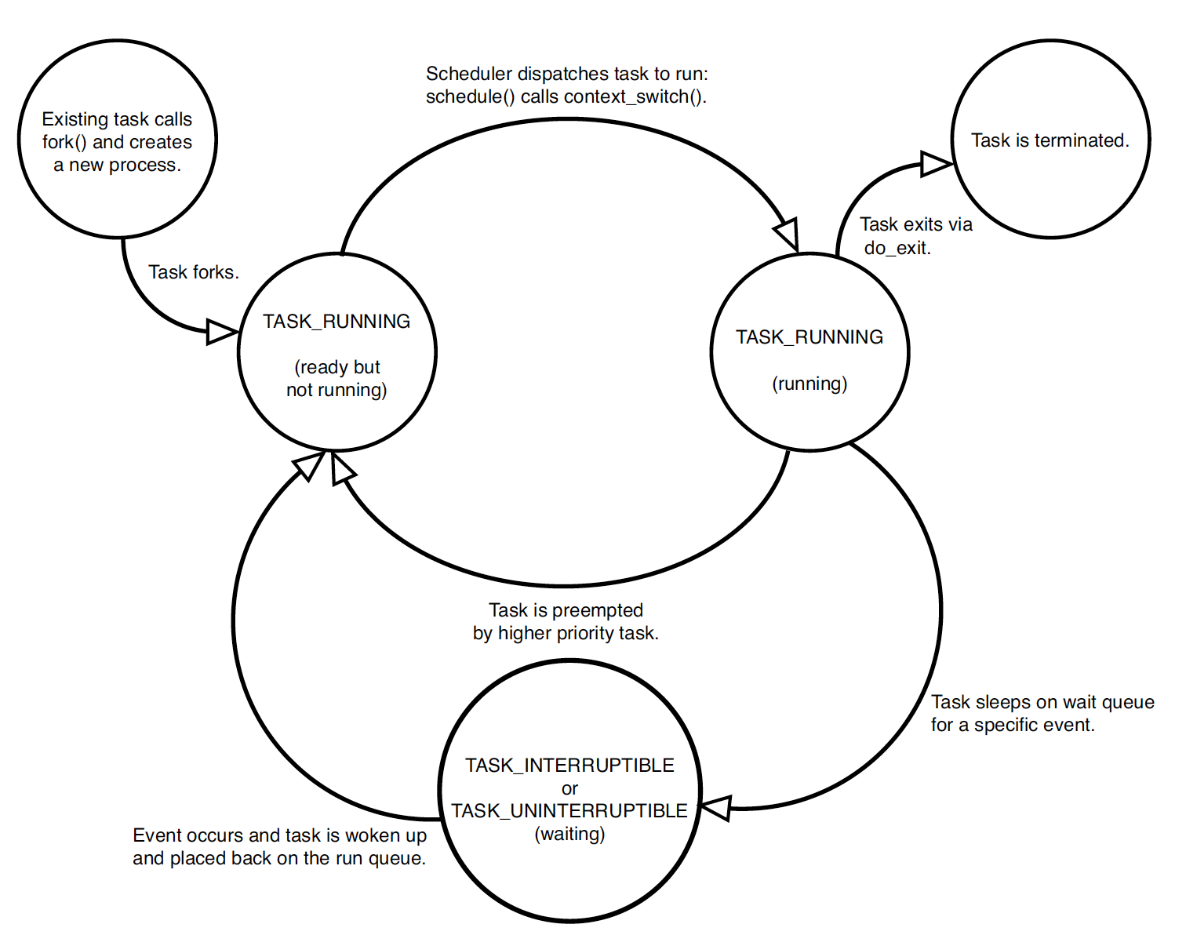
Linux process state

